Slide 1
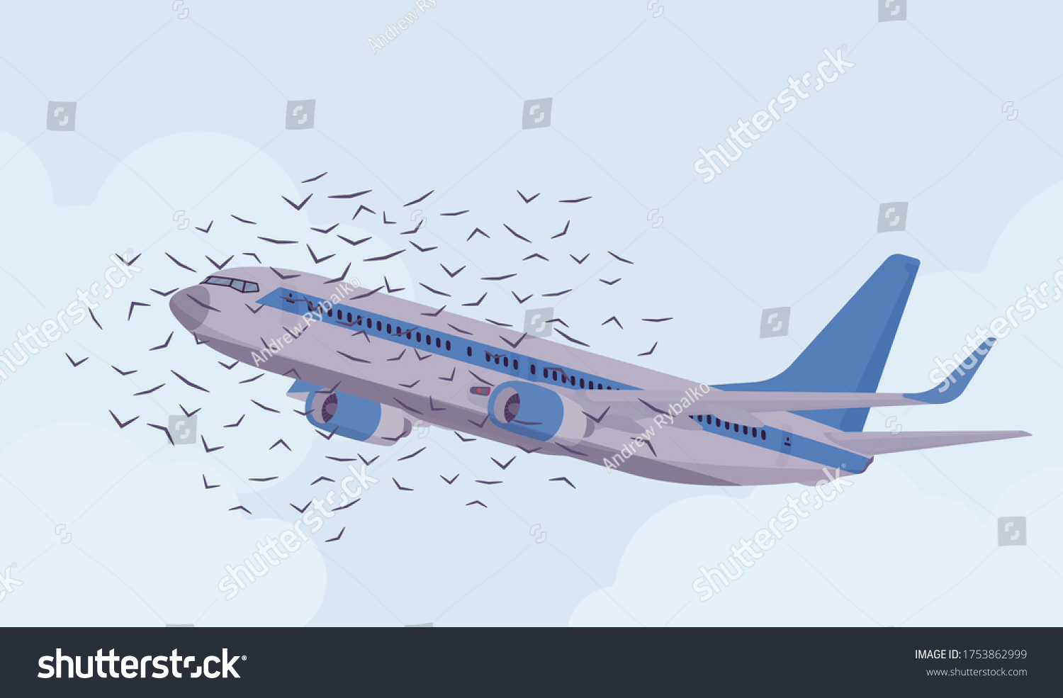
DATA VISUALIZATION OF BIRD STRIKE BETWEEN 2000-2011
BY,
NANDANA GRACE JOHNY

Slide 2
PROJECT DETAILS
Technologies – Data Science
Domain – Transportation and Communication

Slide 3
PROBLEM STATEMENT
Transport and communication are in the crucial domain in the field of analytics. Environmental impacts and safety are, nowadays, two major concerns of the scientific community with respect to transport scenarios and to the ever-growing urban areas. These issues gain more importance due to the increasing amount of vehicles and people. Seeking new solutions is reaching a point where available technologies and artificial intelligence, especially MAS, are being recognized as ways to cope with and tackle these kinds of problems in a distributed and more appropriate way.
A bird strike is strictly defined as a collision between a bird and an aircraft which is in flight or on a take-off or landing roll. The term is often expanded to cover other wildlife strikes - with bats or ground animals. Bird Strike is common and can be a significant threat to aircraft safety. For smaller aircraft, significant damage may be caused to the aircraft structure and all aircraft, especially jet-engine ones, are vulnerable to the loss of thrust which can follow the ingestion of birds into engine air intakes. This has resulted in several fatal accidents.

Slide 4
OBJECTIVE
● Visuals Depicting the Number of Bird Strikes
● Yearly Analysis & Bird Strikes in the US
● Top 10 US Airlines in terms of having encountered bird strikes
● Airports with most incidents of bird strikes – Top 50
● Yearly Cost Incurred due to Bird Strikes:
● When do most bird strikes occur?
● Altitude of aero plane at the time of strike
● Phase of flight at the time of the strike.
● Average Altitude of the aero plane in different phases at the time of strike
● Effect of Bird Strikes & Impact on Flight
● Effect of Strike at Different Altitude
● Were Pilots Informed? & Prior Warning and Effect of Strike Relation

Slide 5
TOOLS USED
Microsoft Excel
Microsoft Power BI
DETAILS OF DATA
Airport/Airline Name
Wildlife: Bird Strikes
Conditions
Total Cost

Slide 6
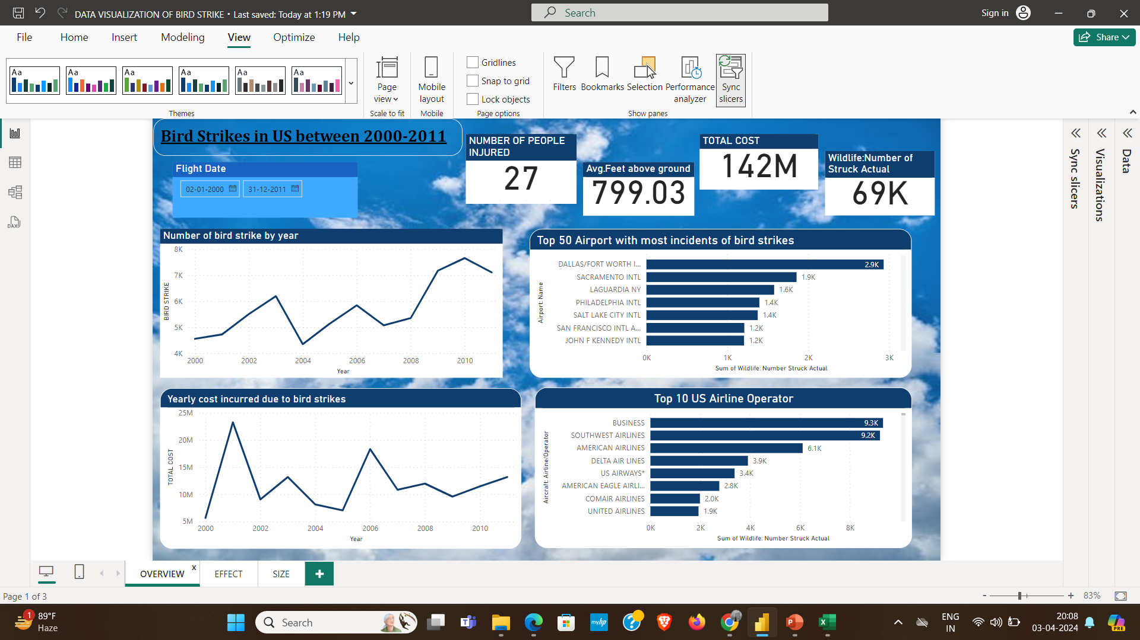
INSIGHTS

Slide 7
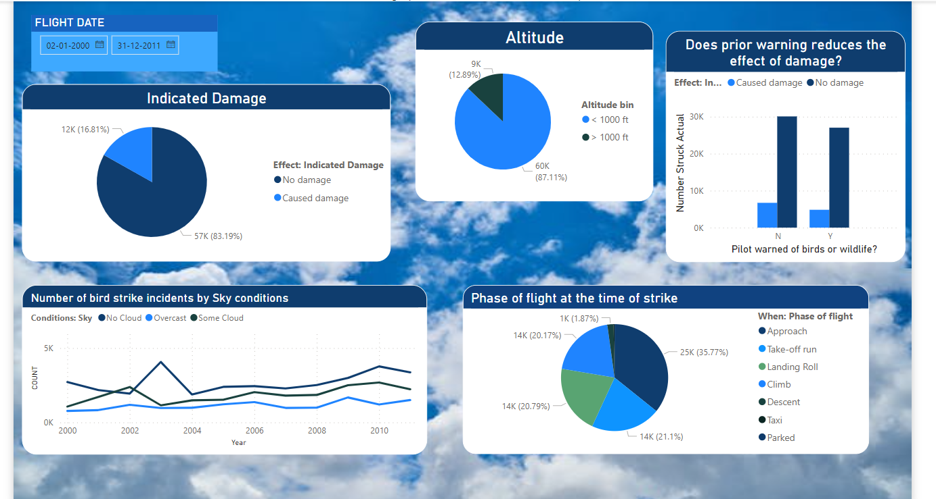

Slide 8
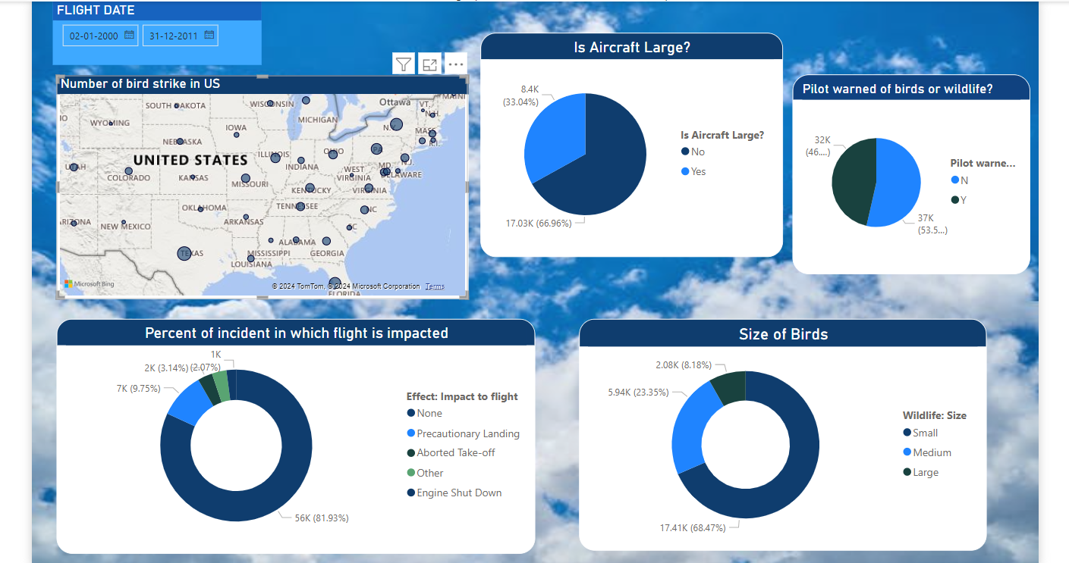

Slide 9
CONCLUSION
53.59% of incidents where the pilot was not warned about the birds.
Prior warning to the pilot reduces the risk of damage to aircraft.
68.47% of incidents have happened due to some small unknown bird.
83.19% of incidents caused no damage while 16.81% of incidents caused damage.
87.11% of bird strike incidents happened when the altitude of the airplane was <1000ft & 12.89% happened when the altitude was >1000ft.
Most of the incidents happened when there was no cloud each year
81.93% of bird strike incidents didn’t impact the flight.

Slide 10
THANK YOU

